Slide 1

Pixels
Iteration 4
Leader: Kem Andrew
Members: Austin Cullar, Taylor Murphy

Slide 2
Summary(Updates)
Our project takes a series of images from an experimental test and converts them to binary black and white images for analysis
Using the difference between each subsequent image our program will be able determine values i.e.(dispersant speed, drop volume) critical to learning how best to extract underground oils lock inside porous structures in the ground
Newly added! – Stitching, and Auto Threshholding

Slide 3
Functional requirements
R1: The system must convert a set of color images into binary images
R2: The system must store and tag each new binary image for troubleshooting purposes
R3: The system must count the up number of each pixel for each individual image and store the data for later use
R4: The system must be able to calculate the proper stitching points for 2 images
R5: The system must graph the gathered data for user analysis
R6: The system must allow for repeatability such that multiple sets of data can be processed in sequence without time consuming GUI navigation

Slide 4
Non Functional Requirements
R1: The system must be able to process many sets of images relevant to a specific surfactant or dispersant
R2: The system must accurately convert color images to binary images such that the difference between flow and non flow areas are obvious
R2.1: The system must determine the proper binary conversion threshold automatically for every image using Otsu’s method
R3: The system must be a self contained executable program that is well documented and intuitive enough for use by individuals without a Computer Science background

Slide 5
Use Case Diagram

Slide 6
Expanded use case
User | System
1. TUCBW User specifies file names | 2. System saves folder names (‘rawDataDir’ folder, and ‘binDataDir’ folder) for future data preservation.
3. User pressing ‘run’ on the GUI | 4. System processes all images in the specified image folder, resulting in a list of binary images which will be saved in the ‘binDataDir’ folder the user previously specified. The resulting binary images are then processed to construct a table of data showing the amount of black and white pixels for each image.
5. TUCEW the user has the choice to save the data, or print the data. | 6. Depending on what the user selects, the system will either create a file in which the data will be saved, or printed

Slide 7
Expanded use case(Stitching)
User | System
1. TUCBW The user selecting the file containing the colored image for stitching | 2. The system saves the folder names (‘rawDataDir’, and ‘binDataDir’ folder) for future data preservation.
3. The user select the ‘stitch’ button on the GUI | 4. The stitching method will go through the images in the file, and combine all of them into one composite image which will be used in future analysis.
5. TUCEW The user has the choice to save or print the data. | 6. Depending on what the user selects, the image will be saved or printed.

Slide 8
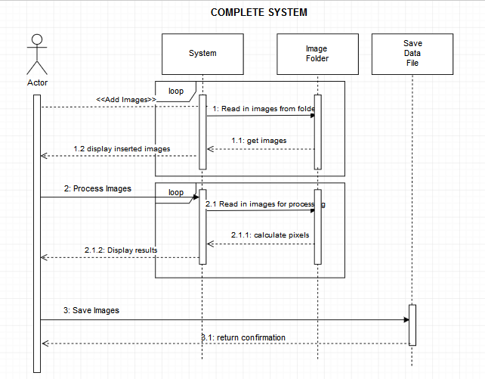

Slide 9
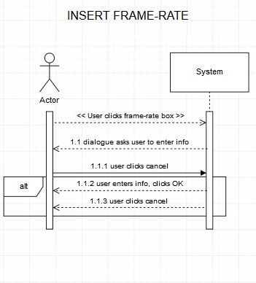

Slide 10
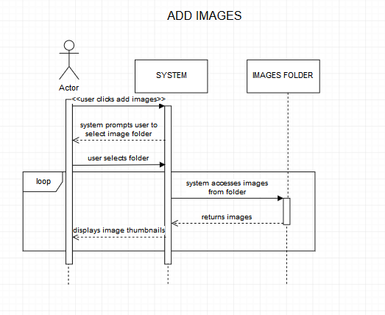

Slide 11
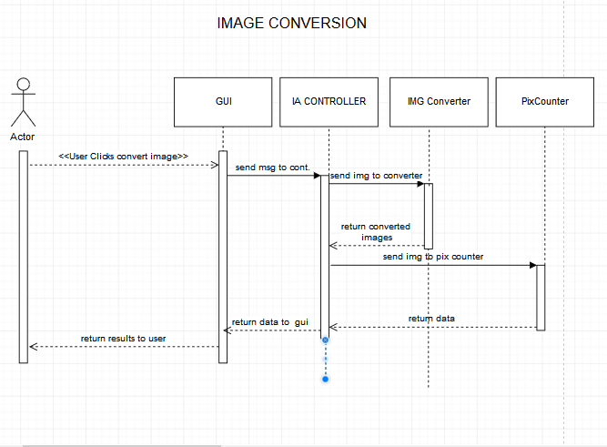

Slide 12
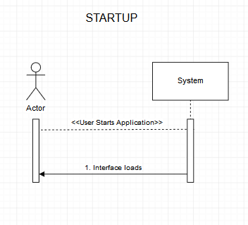

Slide 13
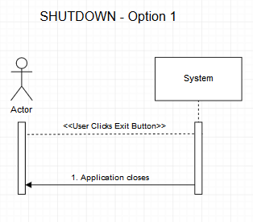

Slide 14
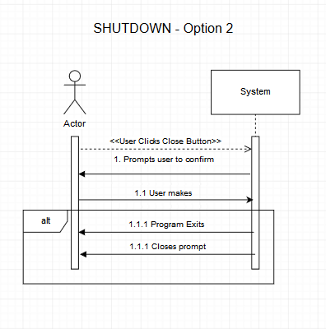

Slide 15
Domain Model

Slide 16
Architectural Model

Slide 17
Team Member Work Accomplished
Taylor: Videos, Functional Requirements, Non Functional Requirements, Controller Code, Threshholding Code
Kem: Videos, Sequence Diagrams, Domain Model, Architectural Model, GUI Code Testing
Austin: Use Case Diagrams, Expanded Use Cases, Stitching code

Slide 18
Schedule
Primary Goals
Thresholding automation
Stitching algorithm
GUI to Controller integration

Slide 19
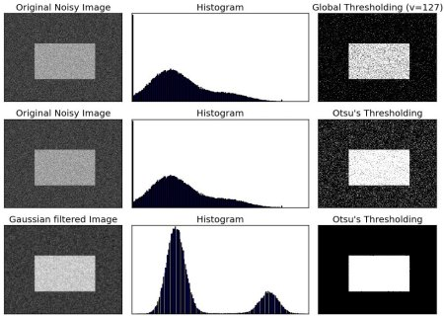
Conversion Threshold Automation
Otsu’s Method
Method of automatically determining necessary threshold for binary image conversion.
Analyses the area surrounding a given pixel and uses that data to determine the best conversion threshold for that picture.
3 Steps
Convert raw color image to Greyscale
Filter the greyscaled image through a Guassian Filter
Apply Otsu’s conversion method to the filtered image

Slide 20
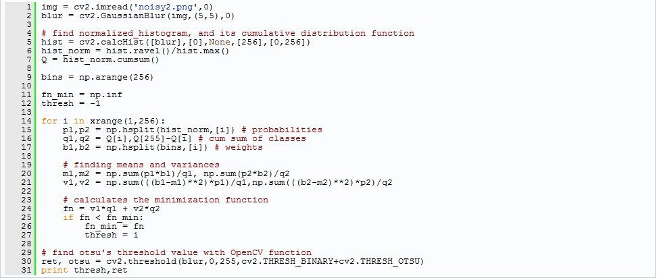
Conversion Threshold Automation (Cont.)

Slide 21
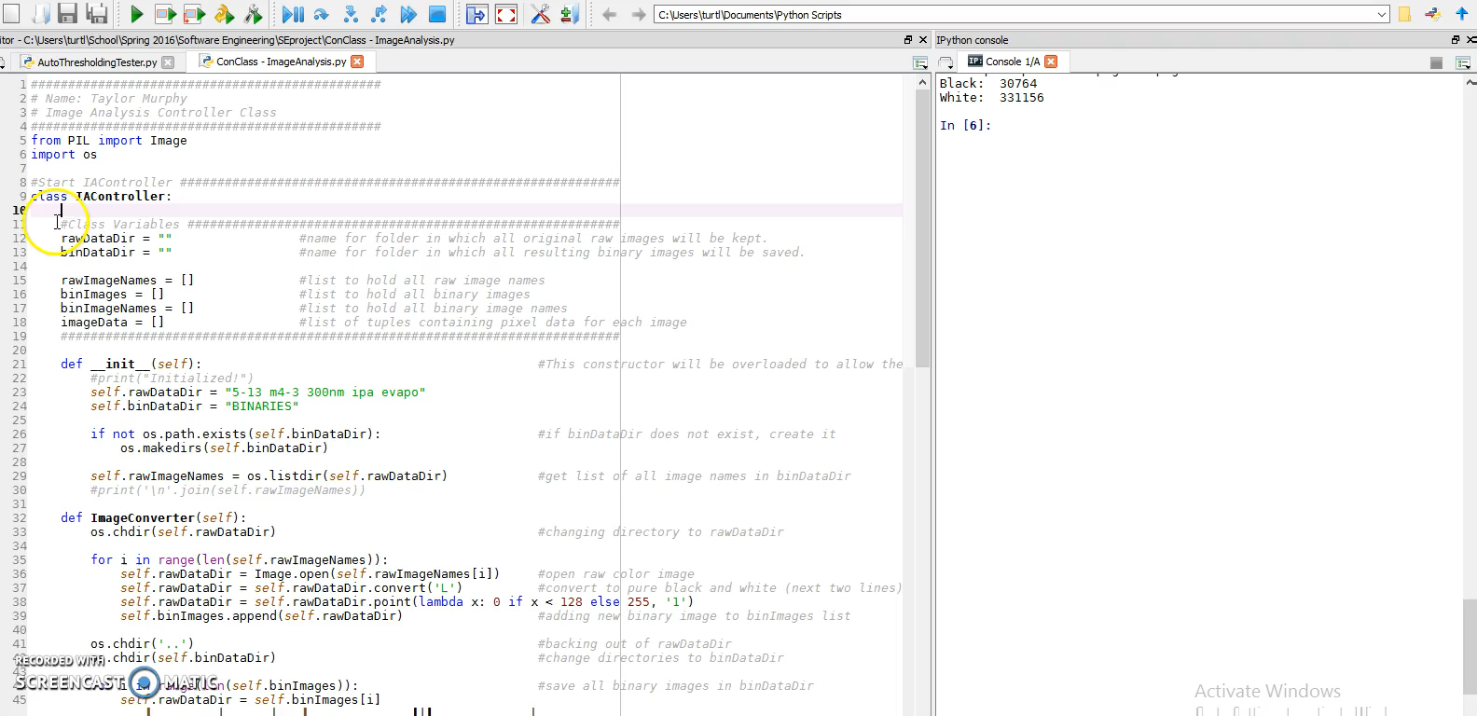

Slide 22
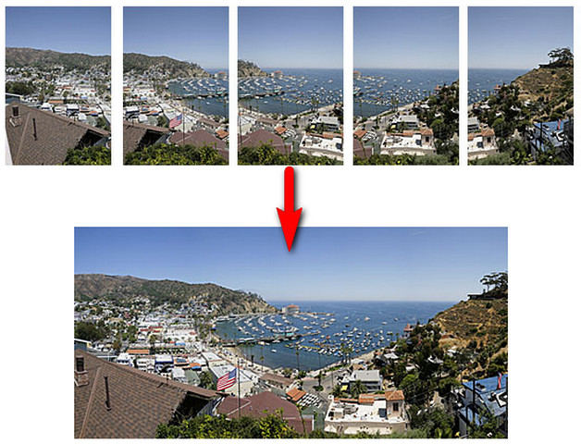
Image Stitching Problem
In our original design, we assumed that each image would be mutually-exclusive - that is, there would be no overlap between images
However, in reality, the sequence of images will contain some overlap

Slide 23
Image Stitching Problem
We need an algorithm to find these “overlaps” and remove them so that no part of any image is processed more than once.
Reasons employing such an algorithm:
Prevent inaccuracies in data
Eliminate human error involved in moving cameras (ideally)

Slide 24
Image Stitching Problem
The heuristic for such an algorithm may be written as follows:
X=1
Compare last X pixel columns of image A with the first X pixel columns of image B.
While (Overlap!=found):
If (image A columns != image B columns):
X+=1
else
Overlap = found
Eliminate Overlap, and stitch images A and B together
(The result of this algorithm will be one large composite image)

Slide 25
Testing
Rapise testing software
Runs in the background while user walks through the use of the program
Current Hurdles
Requires the conversion of the program to a stand alone .exe for analysis
Roadblocks
Conversion to .exe file ruins the program and is therefore currently untestable

Slide 26
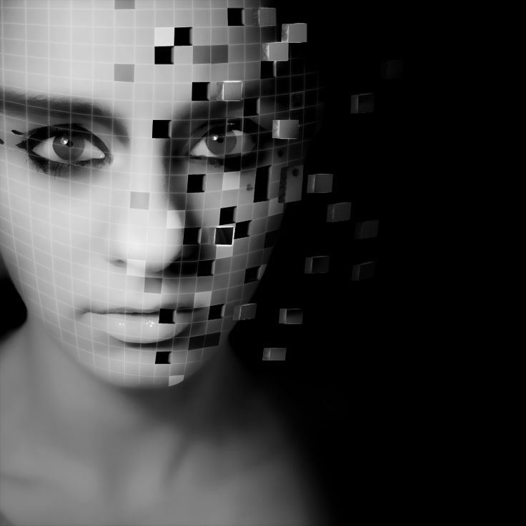
Reality
Loading two images at a time
Logic for comparison of pixels
Indexing issues

Slide 27

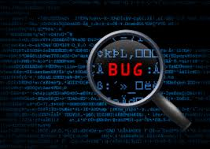
Unfortunate Delay
Due to the current indexing errors, the image stitching functionality of the program will require a little more time to complete
Plans to complete the program

Slide 28
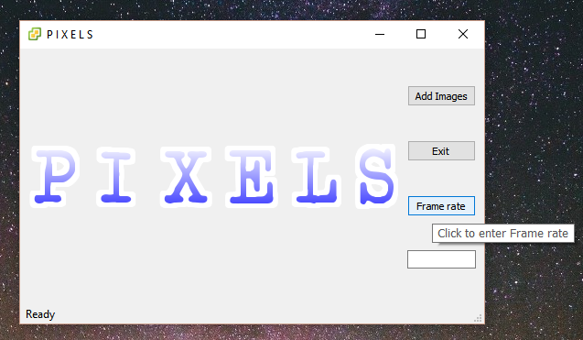
Interface

Slide 29
Interface Labeled
Window Icon
Opens File Explorer
Window Title
Close PIXELS
Clickable Logo
Insert Framerate
Tooltip
Program Status
Framerate Box

Slide 30
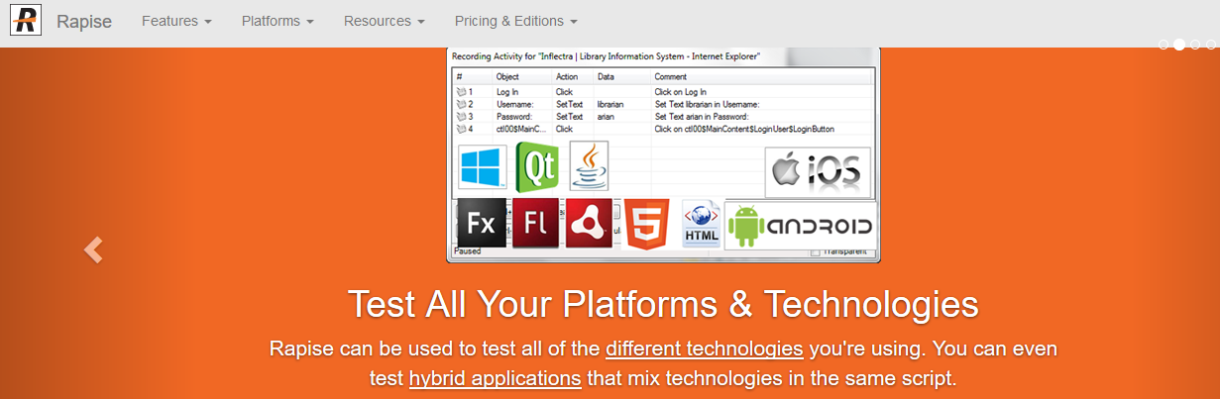
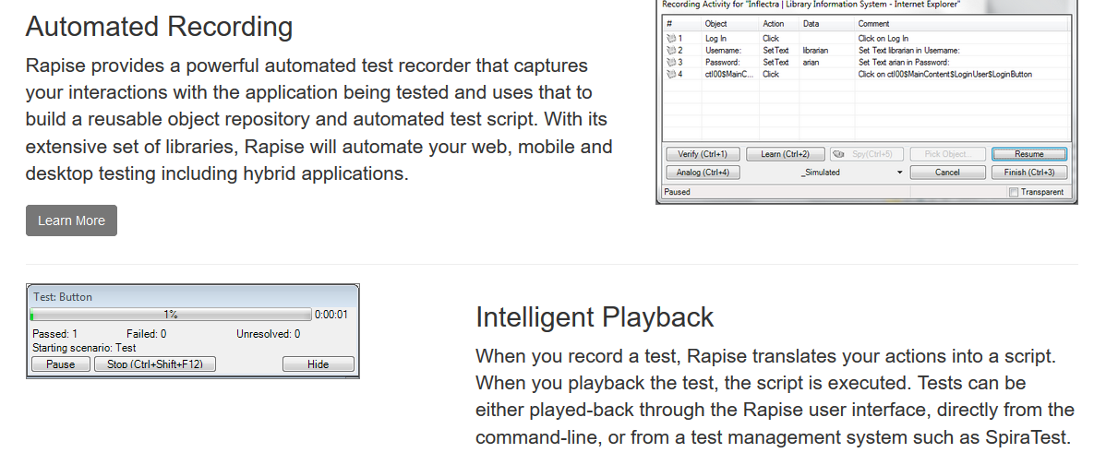
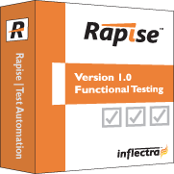
Testing

Slide 31
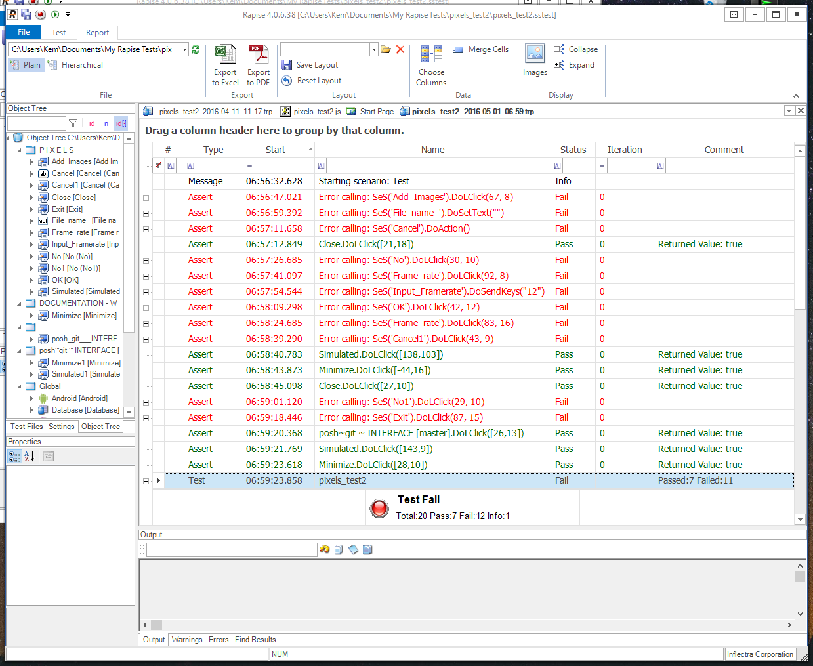
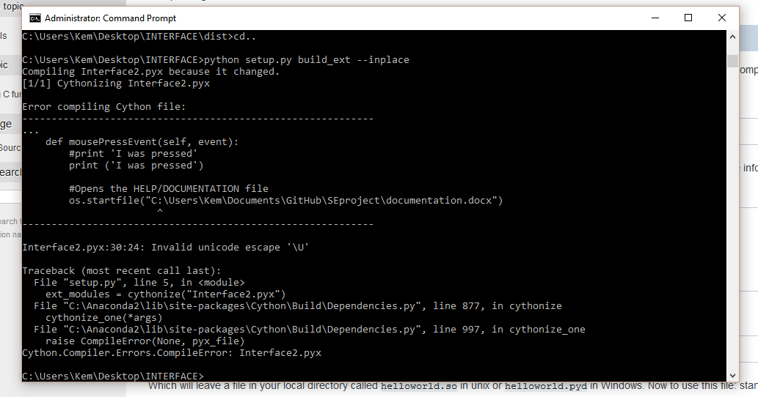
Testing

Slide 32
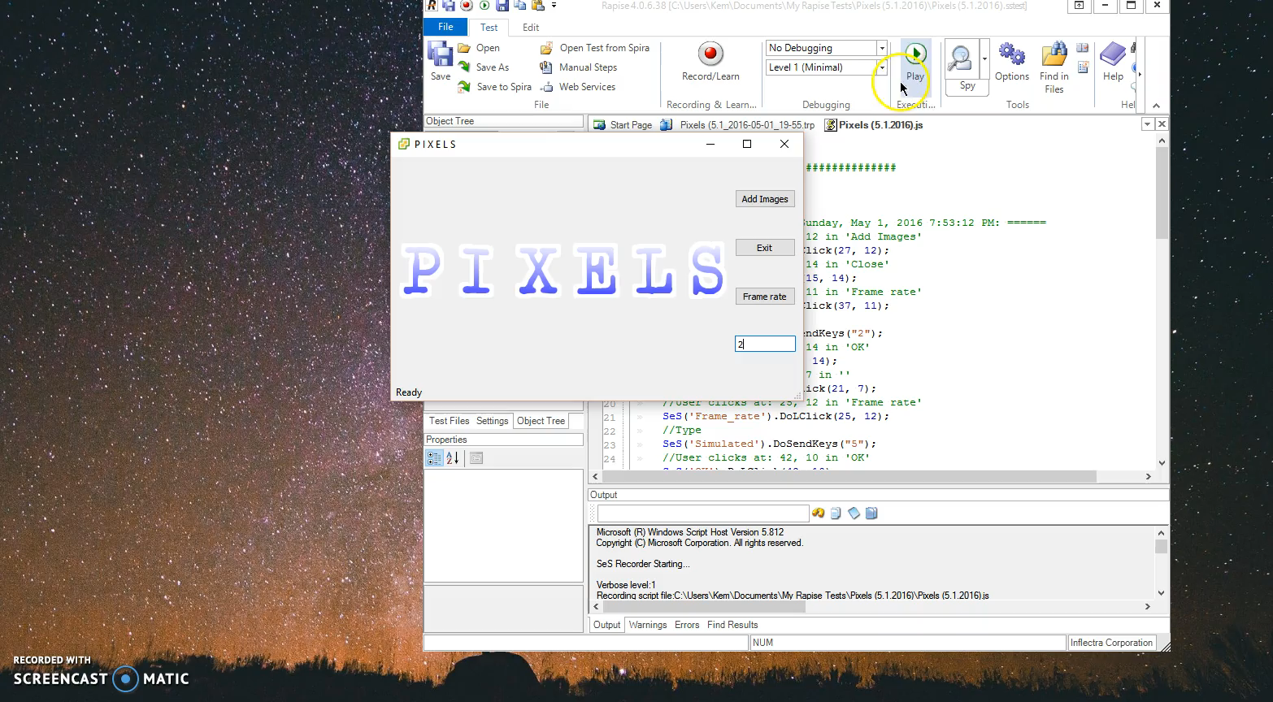
Testing

